Slide 1
Java Script
Module 2

Slide 2
Content
DOM Events
DOM Eventhandlers

Slide 3
DOM Events

Slide 4
JavaScript HTML DOM Events
HTML DOM allows JavaScript to react to HTML events
A JavaScript can be executed when an event occurs, like when a user clicks on an HTML element.
To execute code when a user clicks on an element, add JavaScript code to an HTML event attribute:
onclick=JavaScript
Examples of HTML events:
When a user clicks the mouse
When a web page has loaded
When an image has been loaded
When the mouse moves over an element
When an input field is changed
When an HTML form is submitted
When a user strokes a key

Slide 5
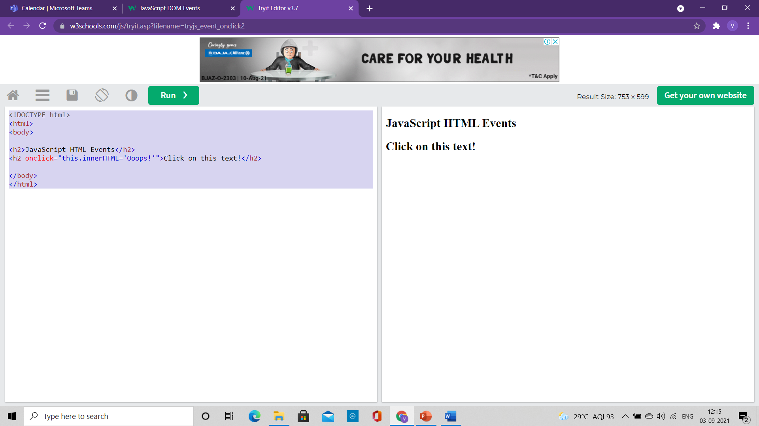
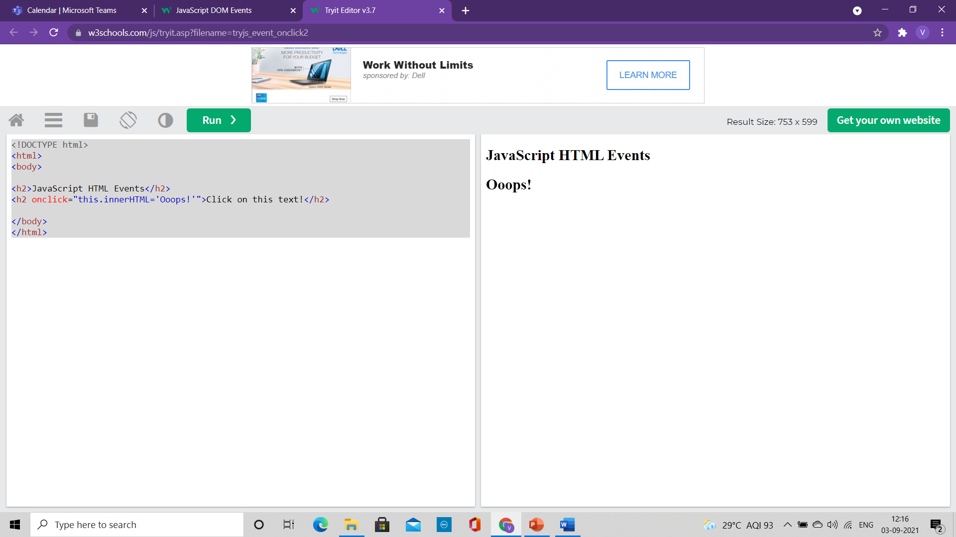
Changing Element with Click
<!DOCTYPE html>
<html>
<body>
<h2>JavaScript HTML Events</h2>
<h2 onclick="this.innerHTML='Ooops!'">Click on this text!</h2>
</body>
</html>
The content of the <h1> element is changed when a user clicks on it

Slide 6
Changing Element with Click
<!DOCTYPE html>
<html>
<body>
<h2>JavaScript HTML Events</h2>
<h2 onclick="changeText(this)">Click on this text!</h2>
<script>
function changeText(id) {
id.innerHTML = "Ooops!";
}
</script>
</body>
</html>
The content of the <h1> element is changed when a user clicks on it.
Here function is called from the event handler

Slide 7
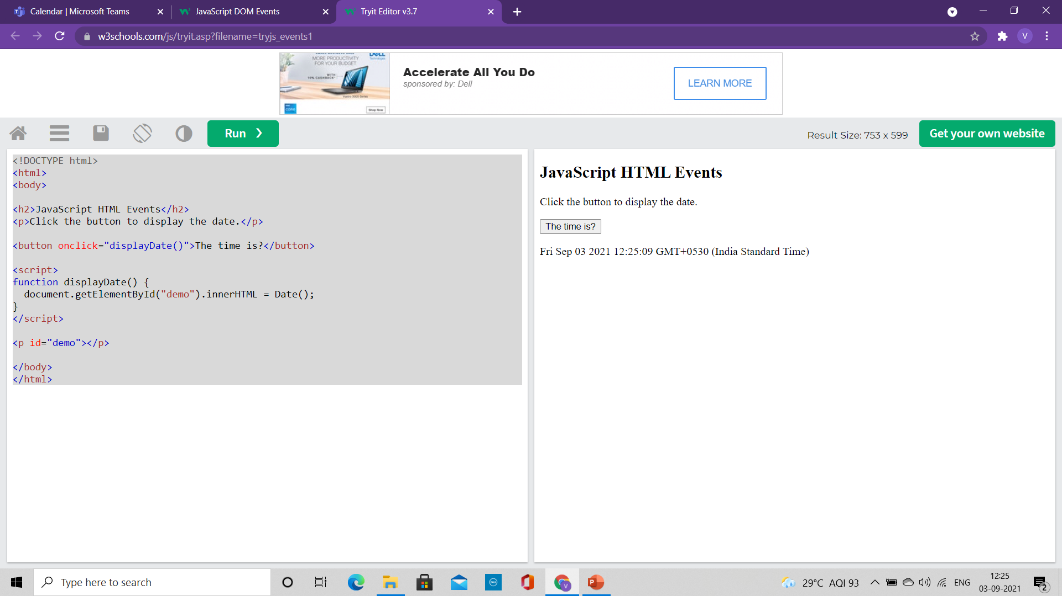
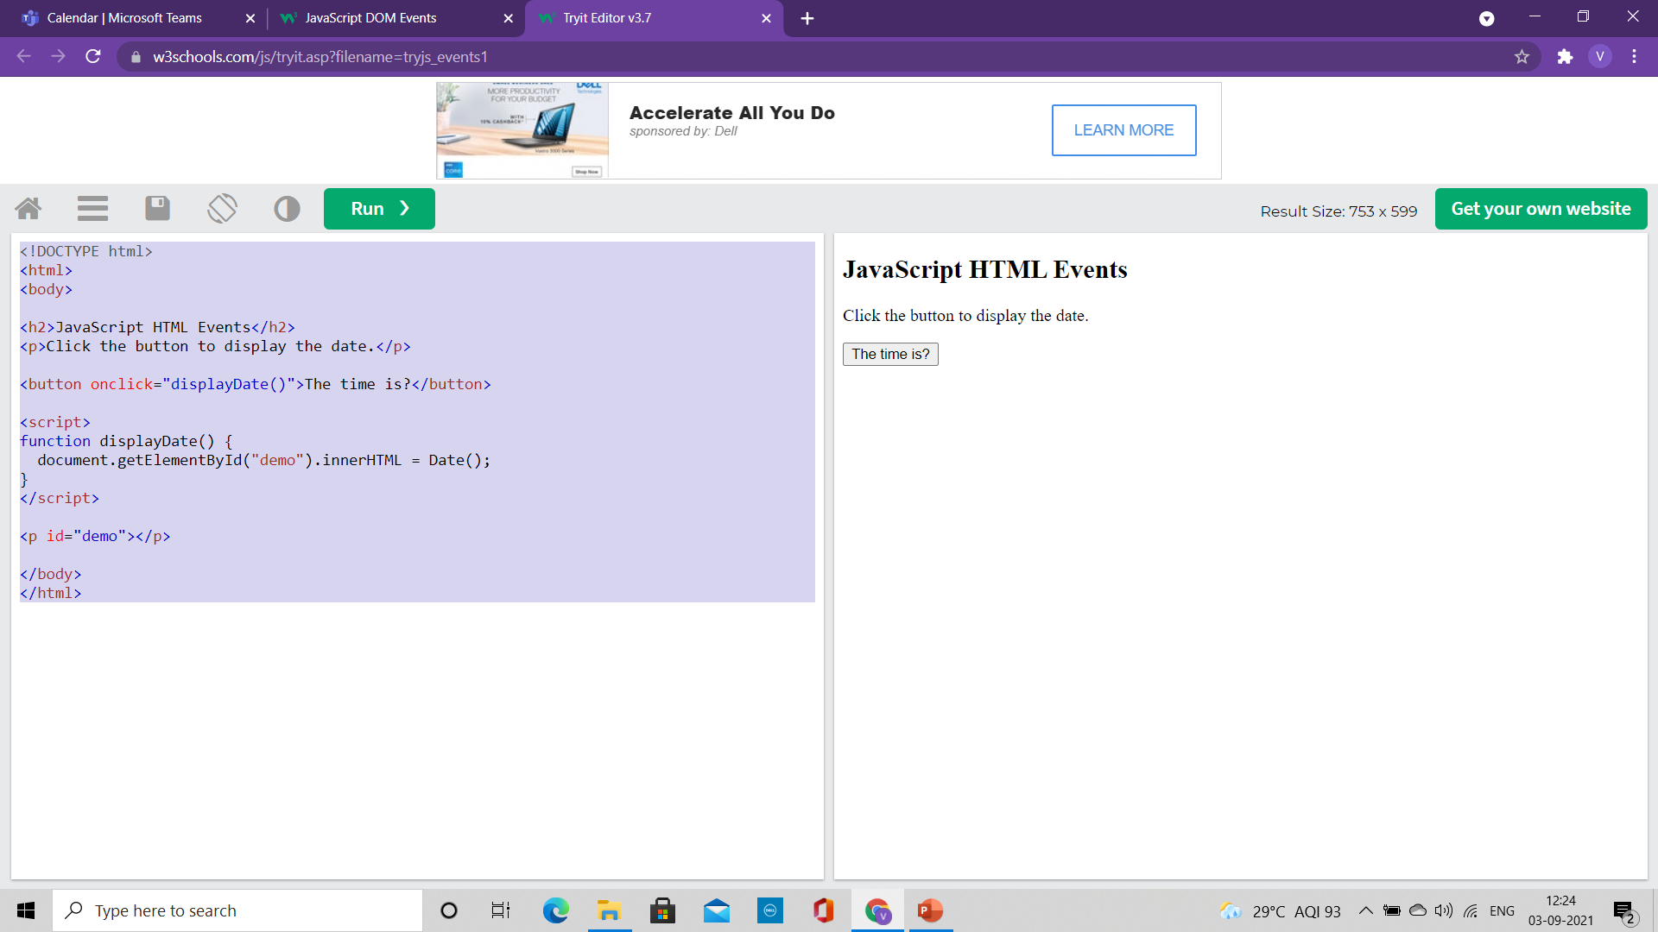
Assign events using Element Attributes
<!DOCTYPE html>
<html>
<body>
<h2>JavaScript HTML Events</h2>
<p>Click the button to display the date.</p>
<button onclick="displayDate()">The time is?</button>
<script>
function displayDate() {
document.getElementById("demo").innerHTML = Date();
}
</script>
<p id="demo"></p>
</body>
</html>
To assign events to HTML elements you can use event attributes.
Assign an onclick event to a button element
For this example, a function named displayDate() will be executed when the button is clicked.

Slide 8
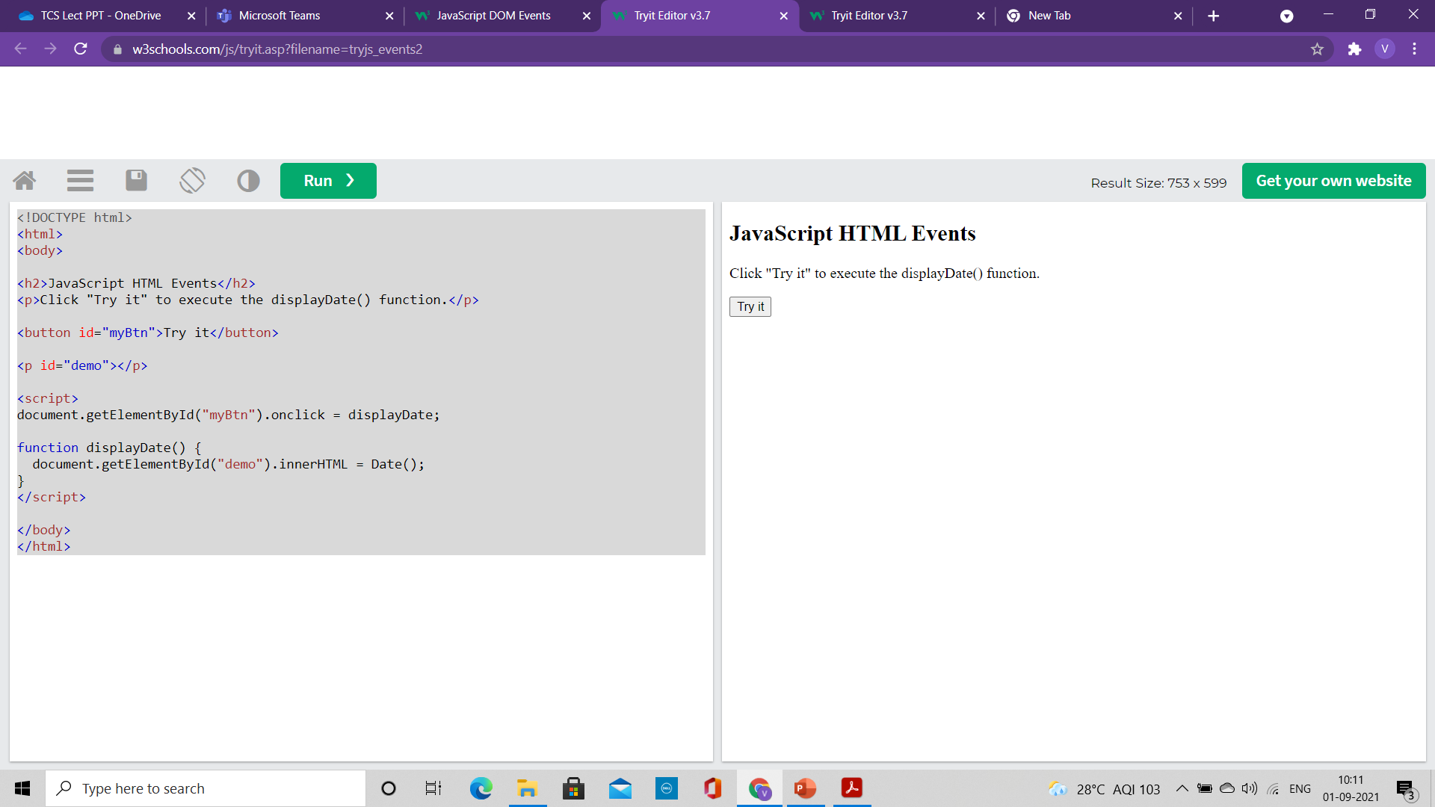
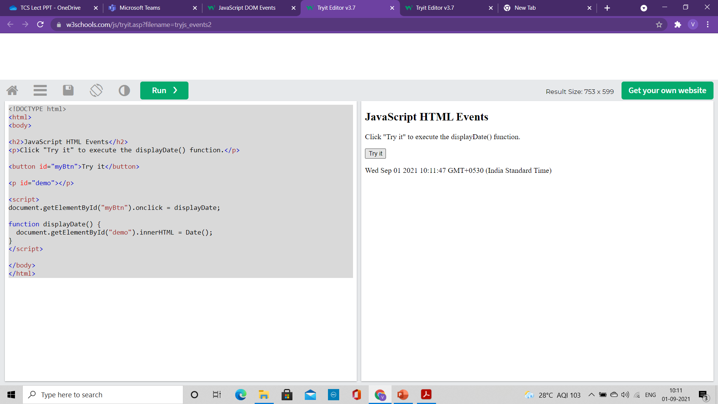
Assign events using HTML DOM
The HTML DOM allows you to assign events to HTML elements using JavaScript
In the example above, a function named displayDate is assigned to an HTML element with the id="myBtn"
<!DOCTYPE html>
<html>
<body>
<h2>JavaScript HTML Events</h2>
<p>Click "Try it" to execute the displayDate() function.</p>
<button id="myBtn">Try it</button>
<p id="demo"></p>
<script>
document.getElementById("myBtn").onclick = displayDate;
function displayDate() {
document.getElementById("demo").innerHTML = Date();
}
</script>
</body>
</html>

Slide 9
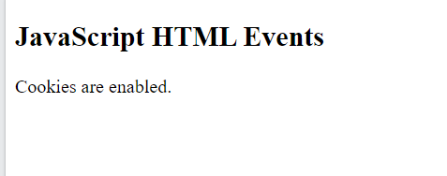
The onload and onunload Events
The onload and onunload events are triggered when the user enters or leaves the page.
The onload event:
Used to check the visitor's browser type and browser version
load the proper version of the web page based on the information.
The onload and onunload events can be used to deal with cookies.
<!DOCTYPE html>
<html>
<body onload="checkCookies()">
<h2>JavaScript HTML Events</h2>
<p id="demo"></p>
<script>
function checkCookies() {
var text = "";
if (navigator.cookieEnabled == true) {
text = "Cookies are enabled.";
} else {
text = "Cookies are not enabled.";
}
document.getElementById("demo").innerHTML = text;
}
</script>
</body>
</html>

Slide 10
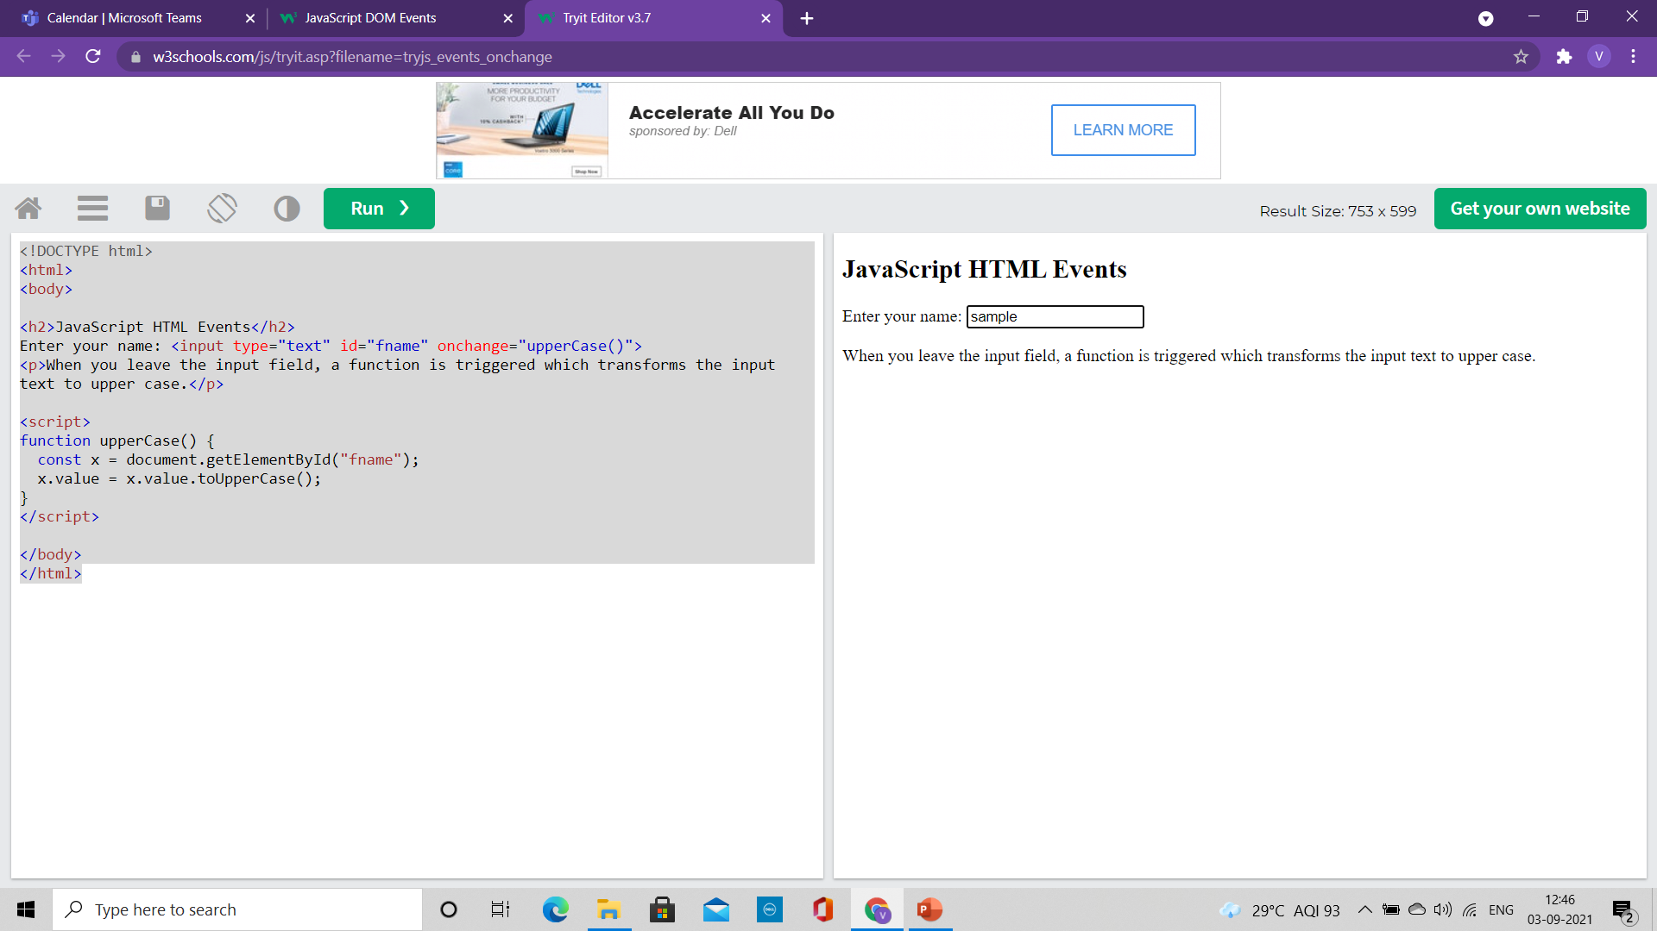
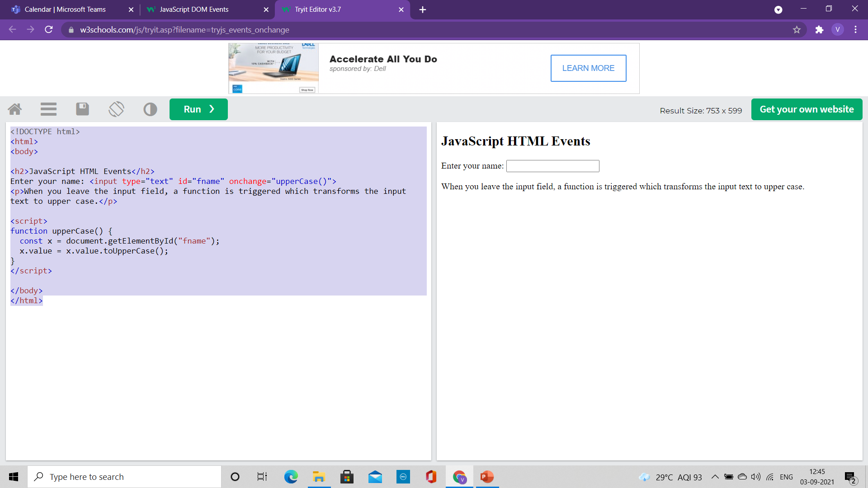

The onchange Events
The onchange event is often used in combination with validation of input fields.
In the example
The upperCase() function will be called when a user changes the content of an input field.
<!DOCTYPE html>
<html>
<body>
<h2>JavaScript HTML Events</h2>
Enter your name: <input type="text" id="fname" onchange="upperCase()">
<p>When you leave the input field, a function is triggered which transforms the input text to upper case.</p>
<script>
function upperCase() {
const x = document.getElementById("fname");
x.value = x.value.toUpperCase();
}
</script>
</body>
</html>

Slide 11
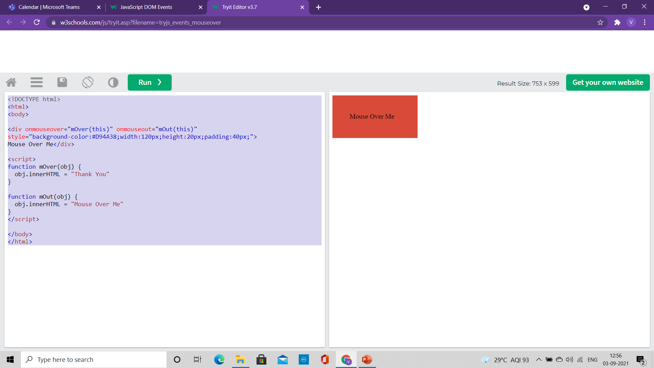
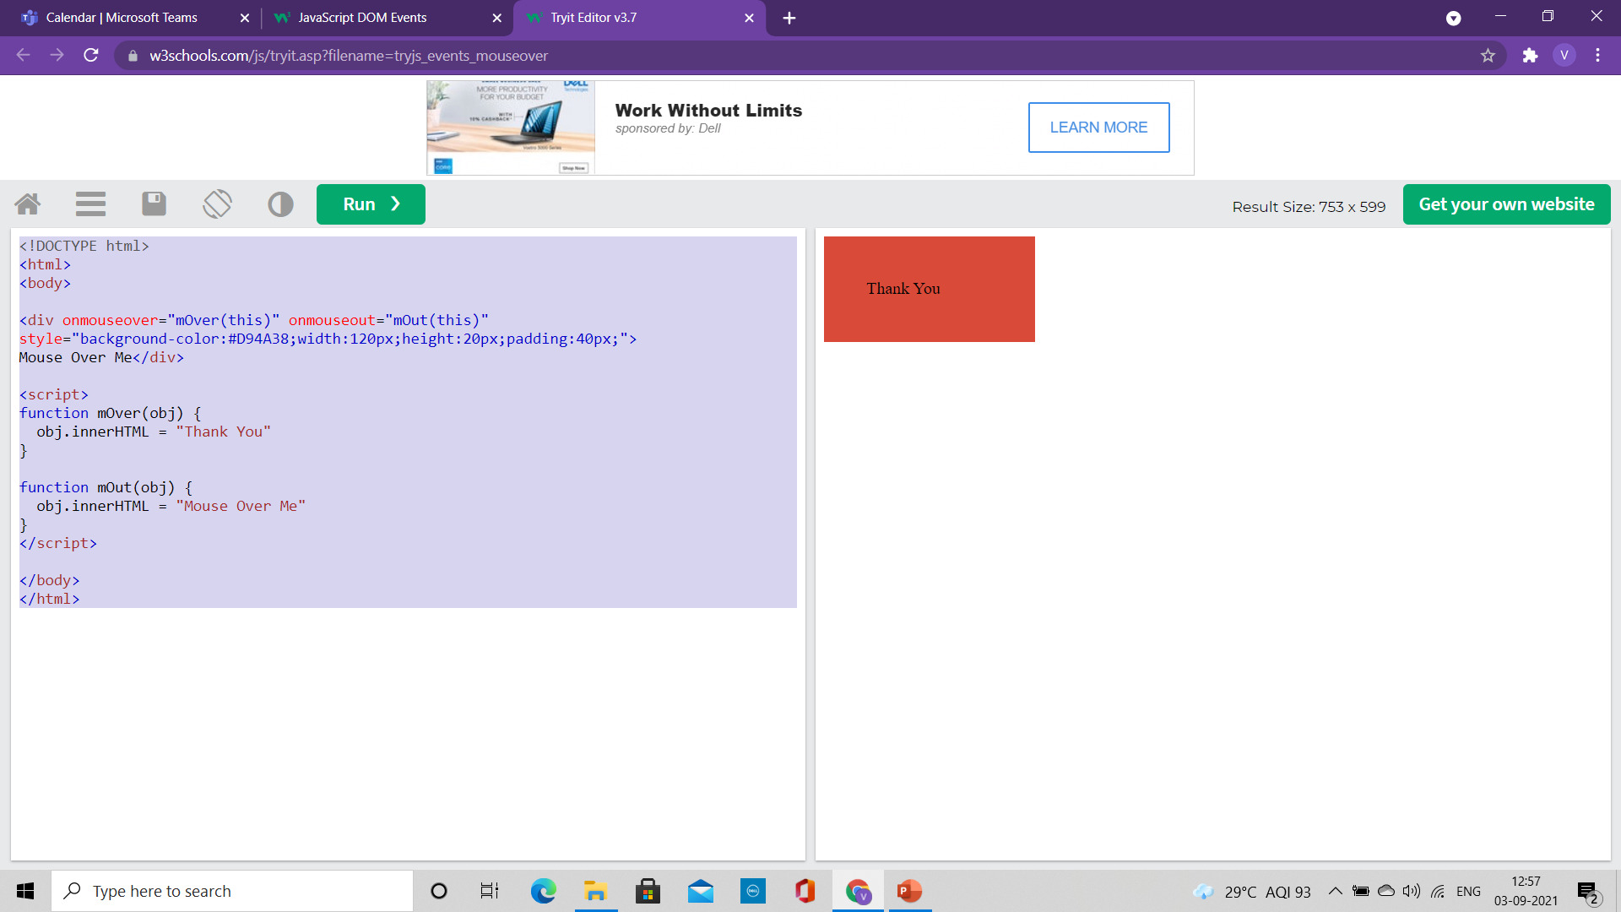
The Mouse Events
<!DOCTYPE html>
<html>
<body>
<div onmouseover="mOver(this)" onmouseout="mOut(this)"
style="background-color:#D94A38;width:120px;height:20px;padding:40px;">
Mouse Over Me</div>
<script>
function mOver(obj) {
obj.innerHTML = "Thank You"
}
function mOut(obj) {
obj.innerHTML = "Mouse Over Me"
}
</script>
</body>
</html>
The onmouseover event
The onmouseout events
They can be used to trigger a function when the user mouses over, or out of, an HTML element

Slide 12
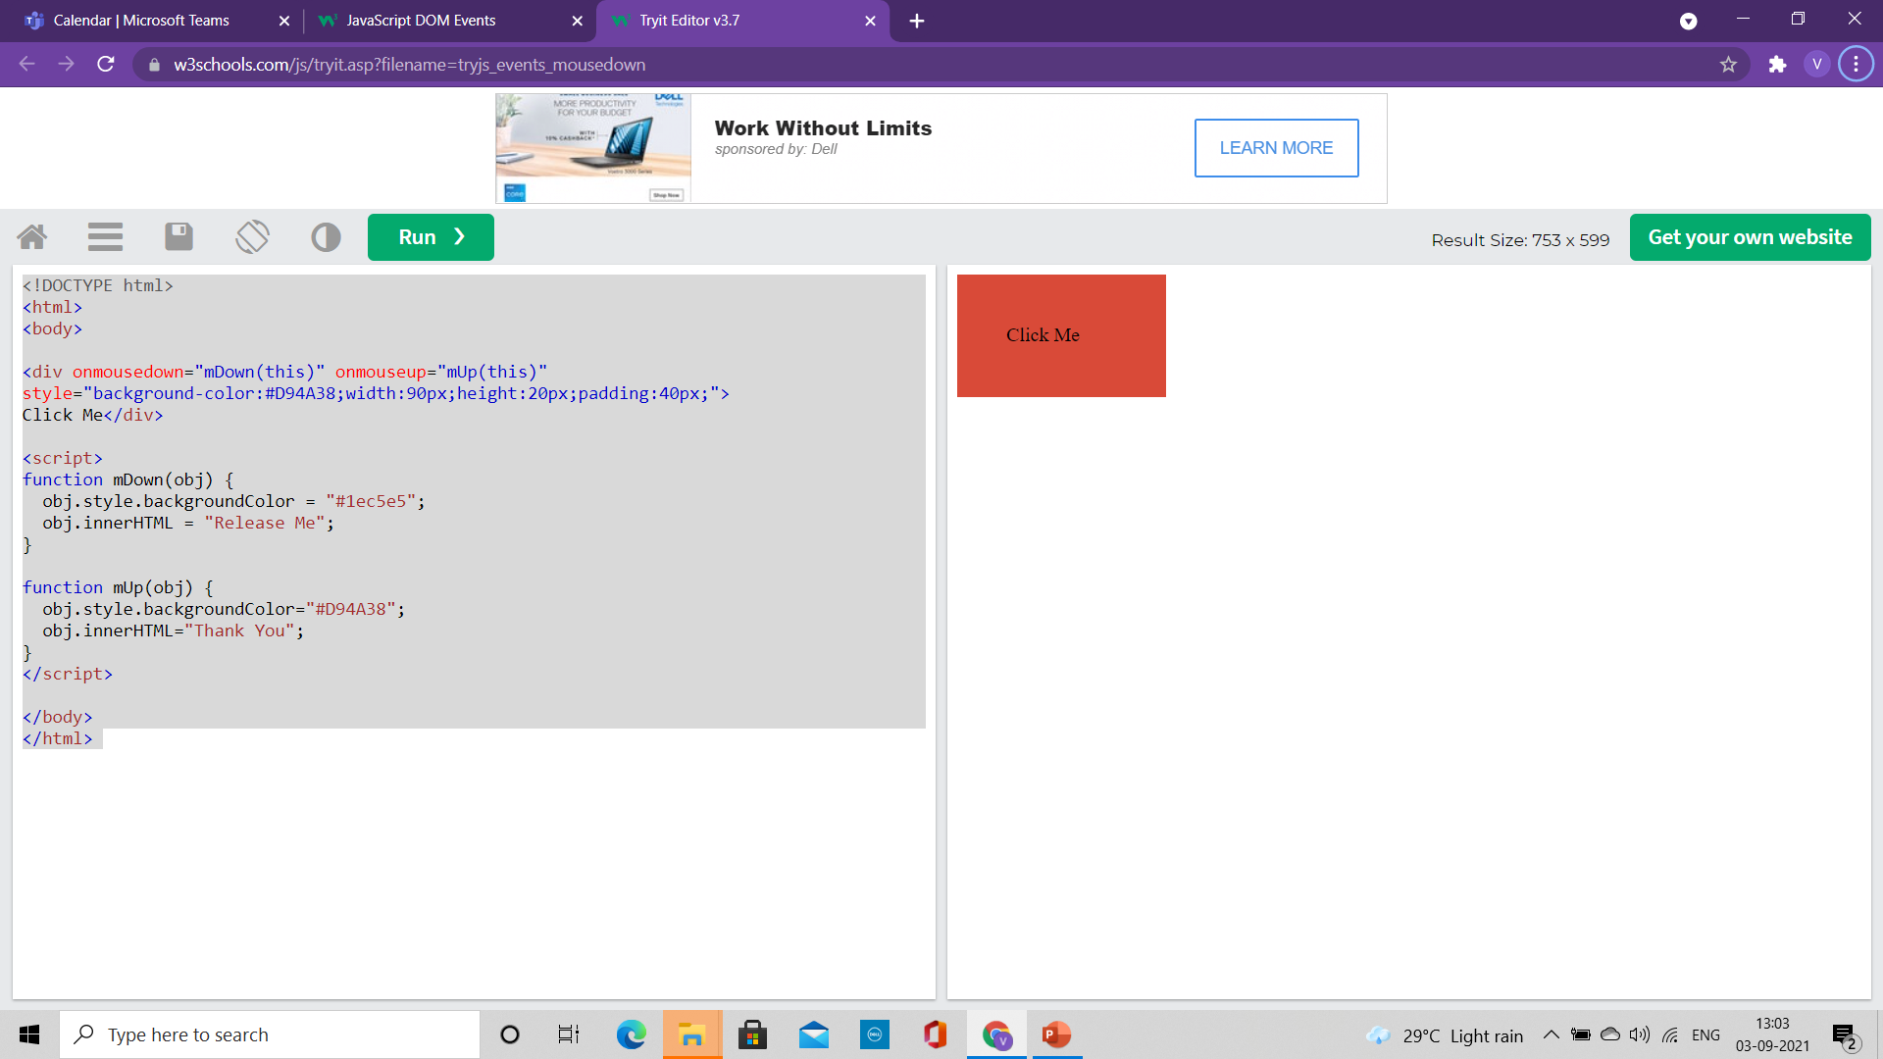
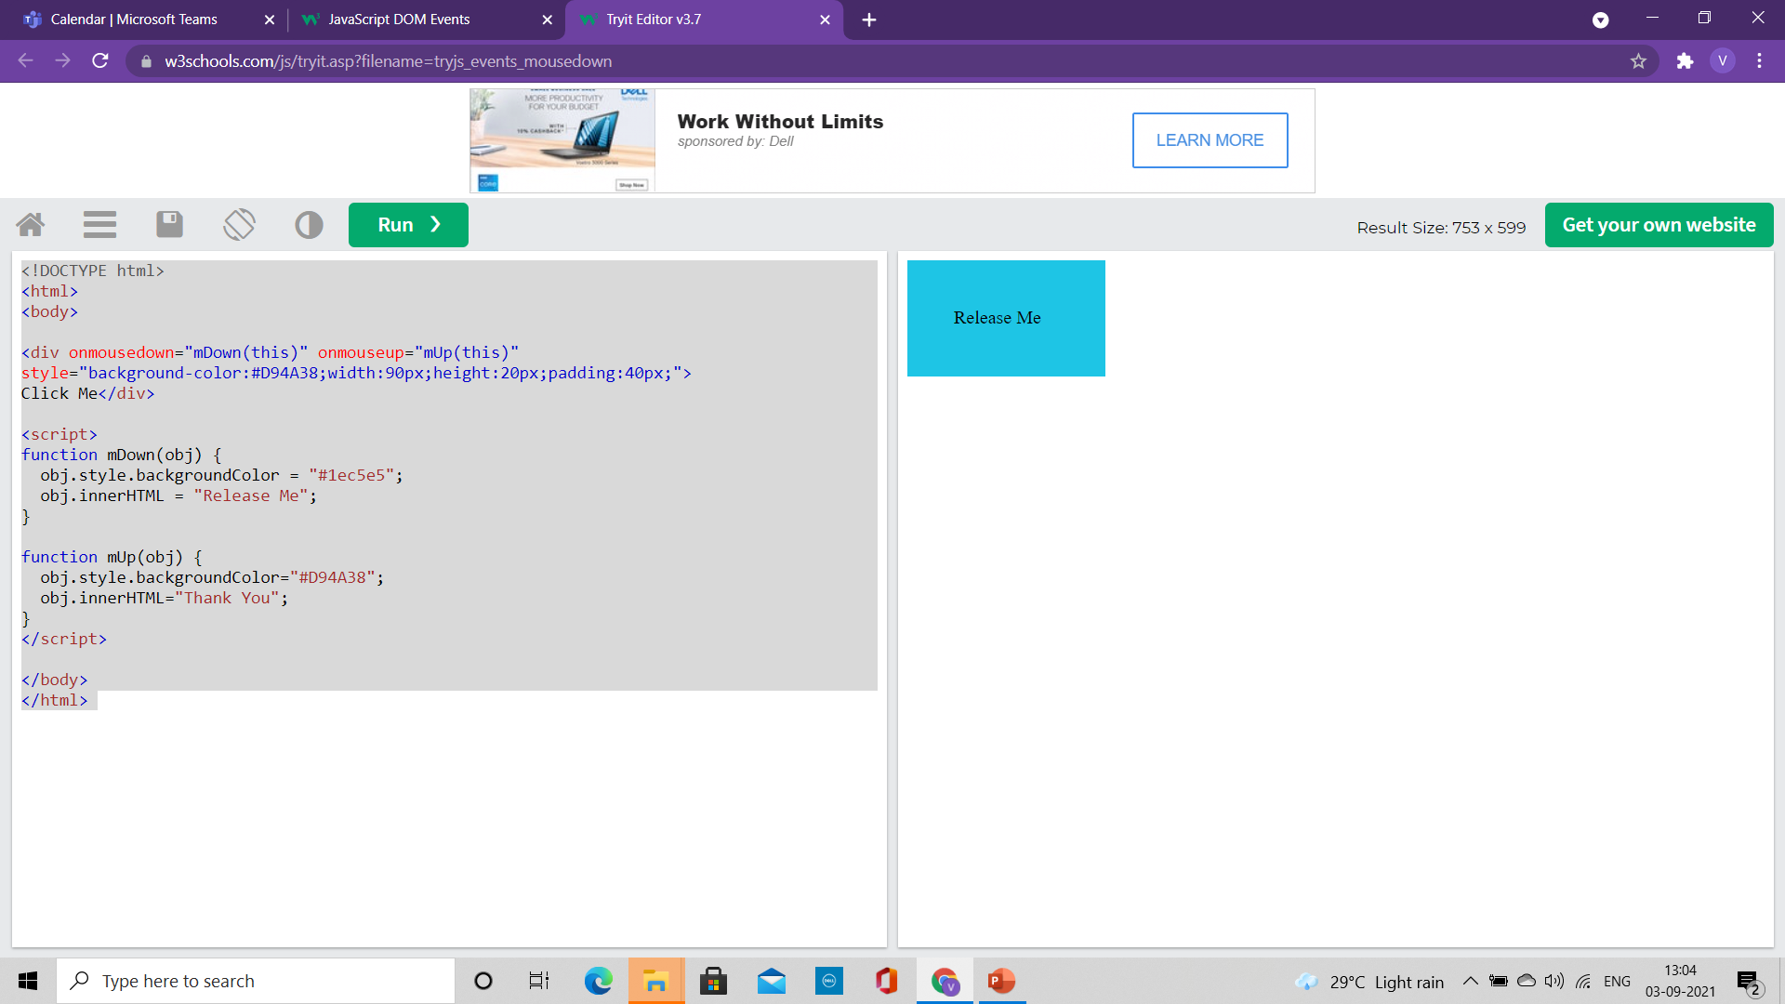

The Mouse Events
<!DOCTYPE html>
<html>
<body>
<div onmousedown="mDown(this)" onmouseup="mUp(this)"
style="background-color:#D94A38;width:90px;height:20px;padding:40px;">
Click Me</div>
<script>
function mDown(obj) {
obj.style.backgroundColor = "#1ec5e5";
obj.innerHTML = "Release Me";
}
function mUp(obj) {
obj.style.backgroundColor="#D94A38";
obj.innerHTML="Thank You";
}
</script>
</body>
</html>
onmousedown event: when a mouse-button is clicked, the onmousedown event is triggered
onmouseup event: when the mouse-button is released, the onmouseup event is triggered
onclick event: when the mouse-click is completed, the onclick event is triggered

Slide 13
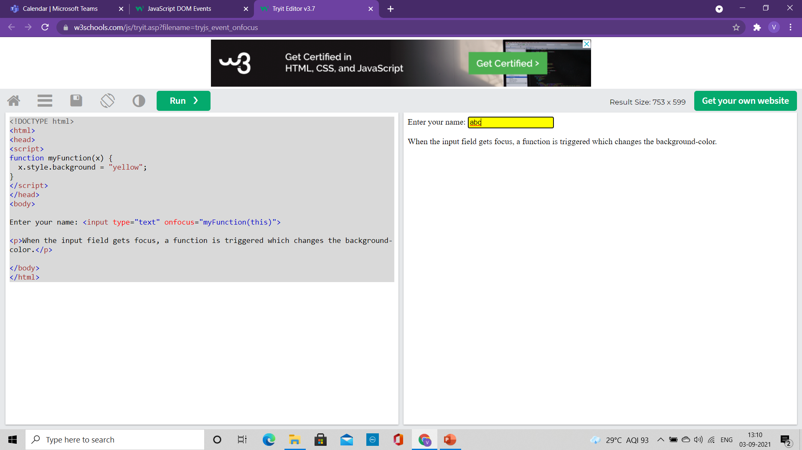
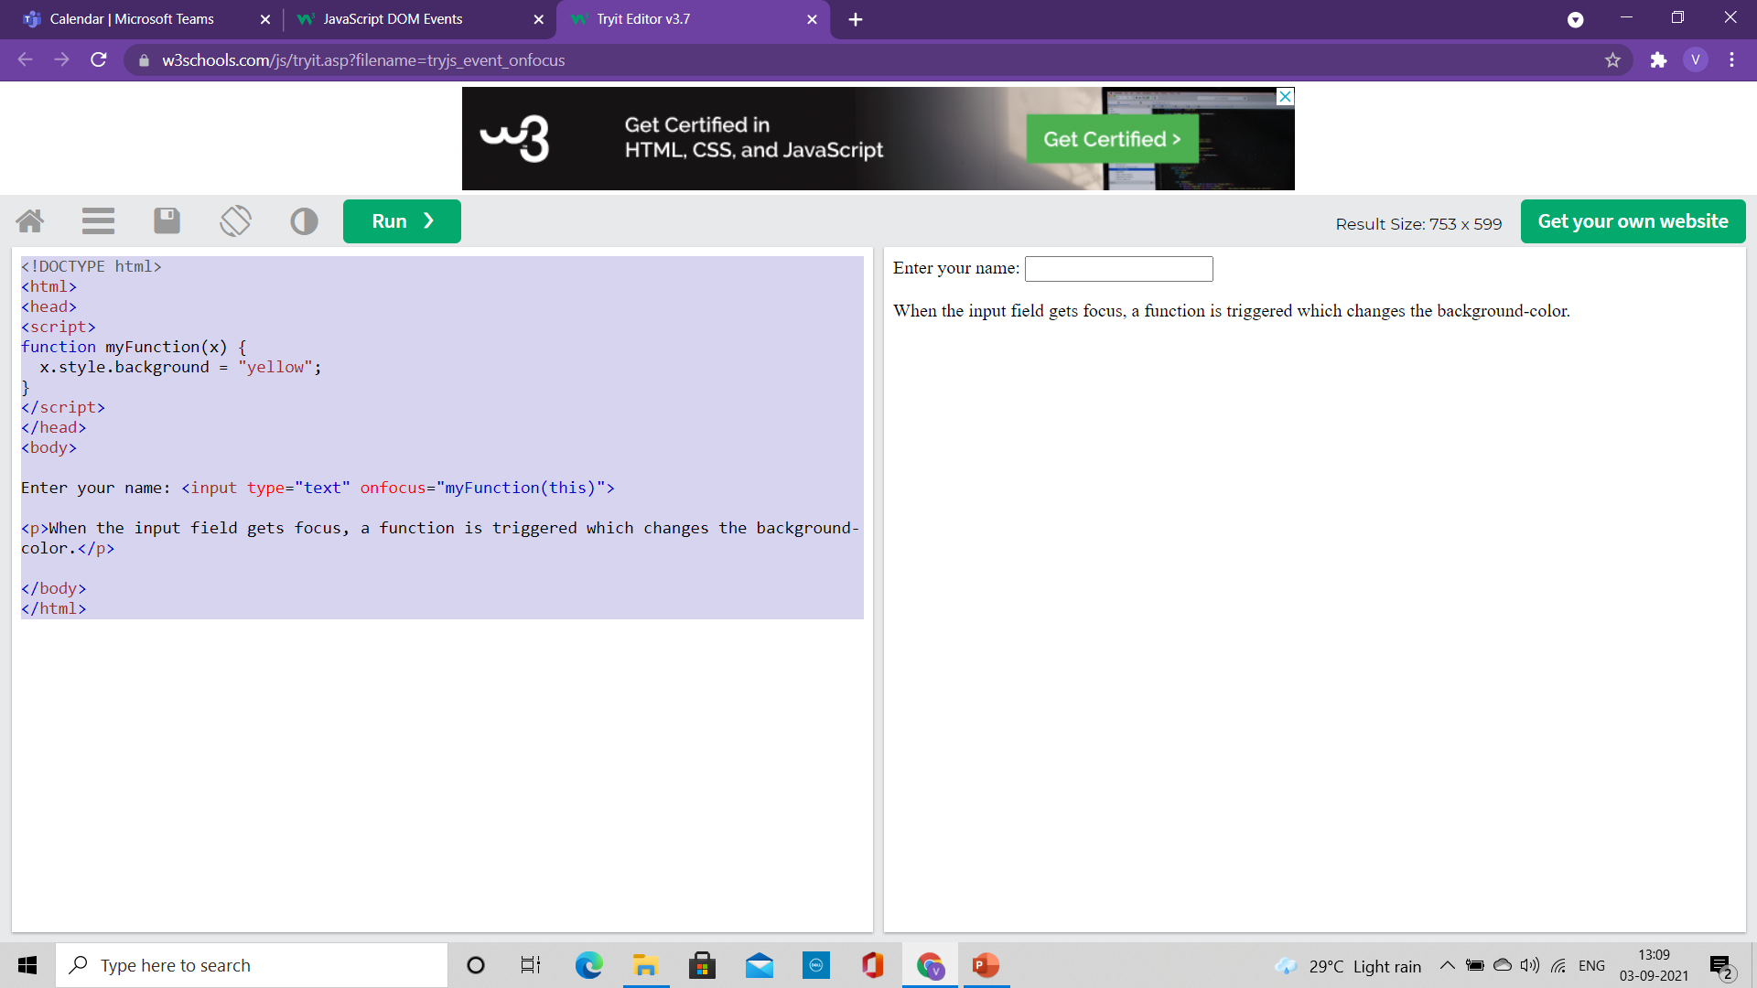
The onfocus Events
<!DOCTYPE html>
<html>
<head>
<script>
function myFunction(x) {
x.style.background = "yellow";
}
</script>
</head>
<body>
Enter your name: <input type="text" onfocus="myFunction(this)">
<p>When the input field gets focus, a function is triggered which changes the background-color.</p>
</body>
</html>
onfocus event: Change the background-color of an input field when it gets focus.

Slide 14
DOM EventListener

Slide 15
The addEventListener() method
It attaches an event handler to the specified element.
It attaches an event handler to an element without overwriting existing event handlers.
We can add many event handlers to one element.
We can add many event handlers of the same type to one element, i.e two "click" events.
We can add event listeners to any DOM object not only HTML elements. i.e the window object.
The addEventListener() method makes it easier to control how the event reacts to bubbling.
When using the addEventListener() method, the JavaScript is separated from the HTML markup, for better readability and allows you to add event listeners even when you do not control the HTML markup.
We can easily remove an event listener by using the removeEventListener() method.

Slide 16
The addEventListener() method
Syntax:
element.addEventListener(event, function, useCapture);
The first parameter is the type of the event (like "click" or "mousedown" or any other HTML DOM Event.)
The second parameter is the function we want to call when the event occurs.
The third parameter is a boolean value specifying whether to use event bubbling or event capturing. This parameter is optional.
Note that you don't use the "on" prefix for the event; use "click" instead of "onclick".

Slide 17
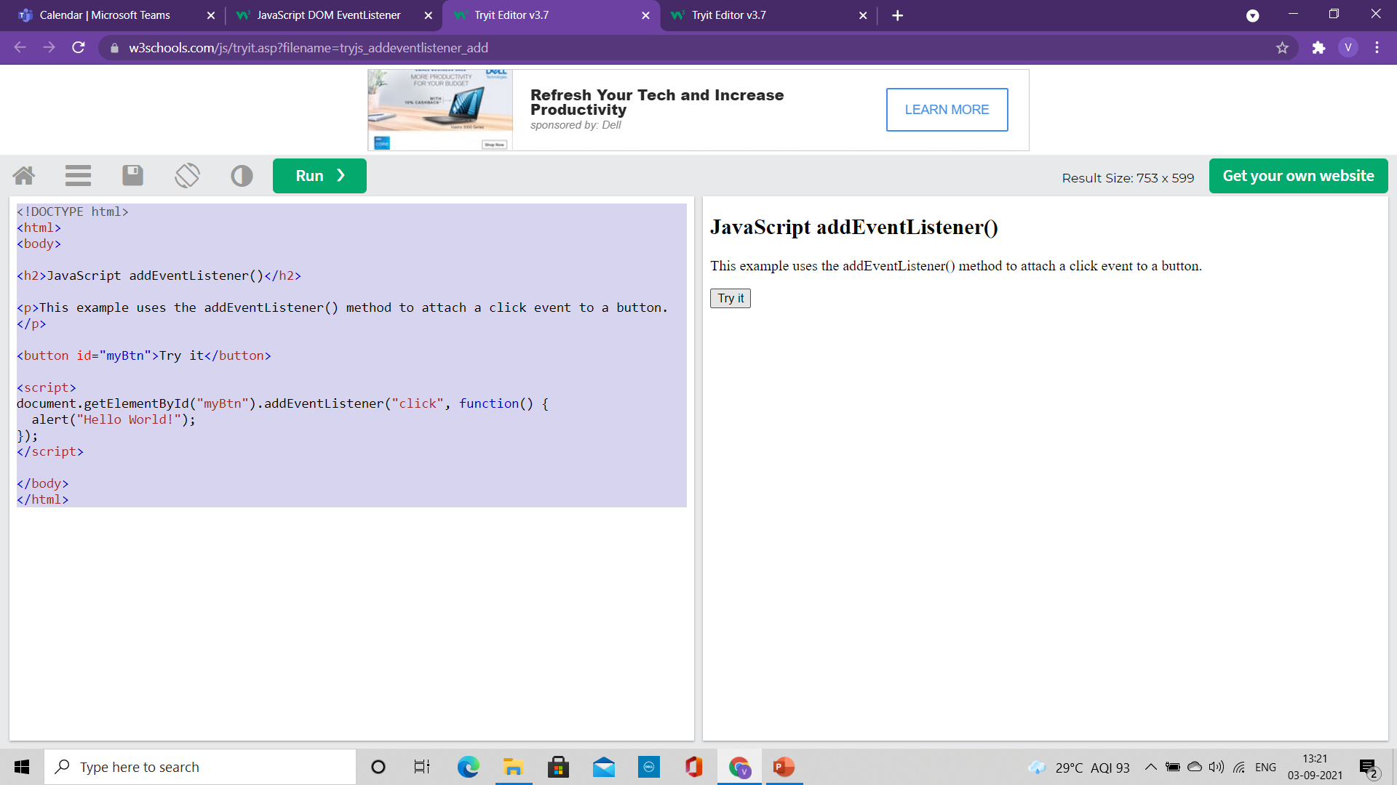
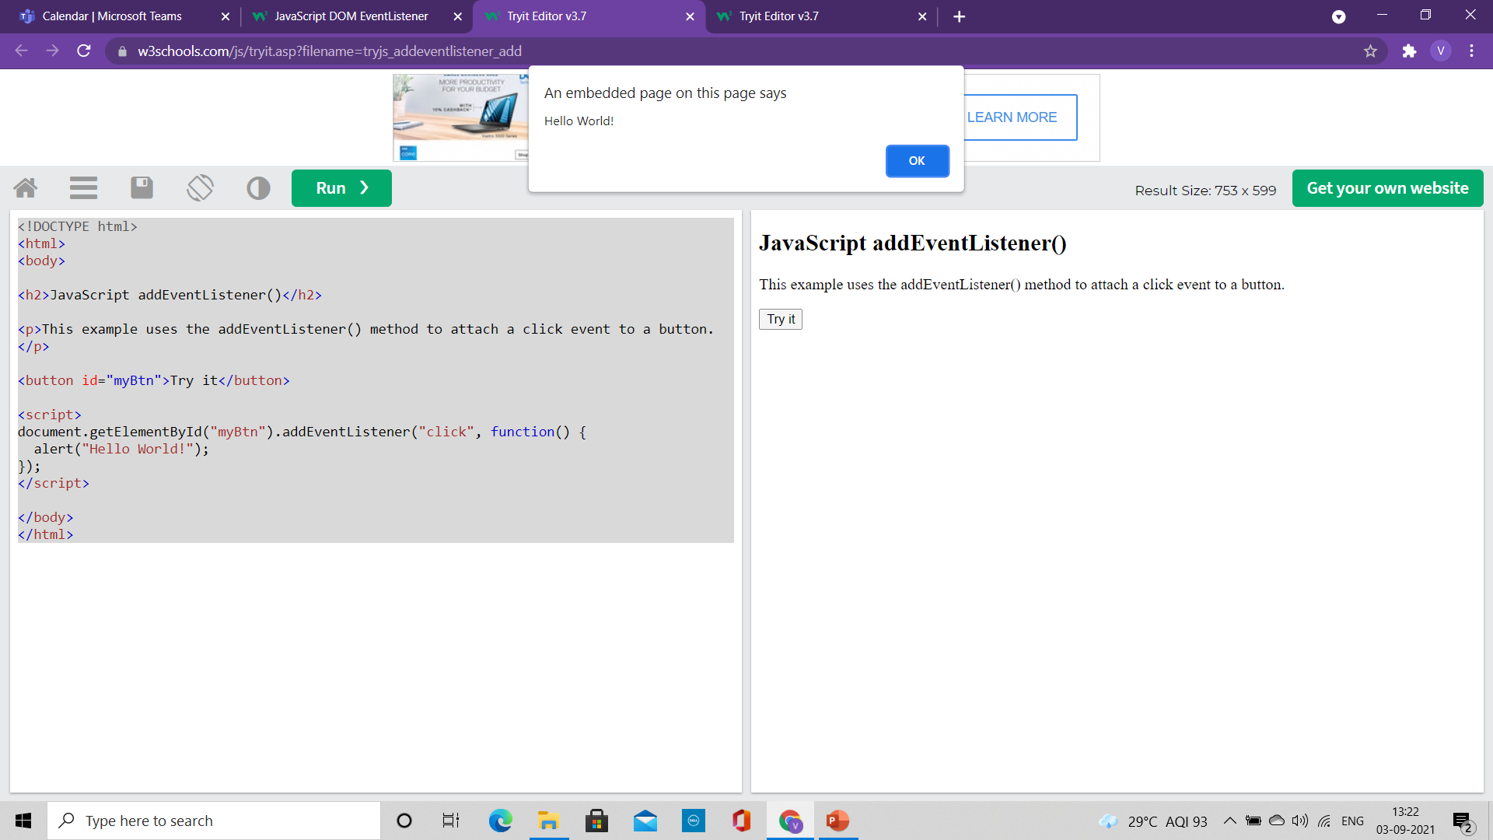
Example
<!DOCTYPE html>
<html>
<body>
<h2>JavaScript addEventListener()</h2>
<p>This example uses the addEventListener() method to attach a click event to a button.</p>
<button id="myBtn">Try it</button>
<script>
document.getElementById("myBtn").addEventListener("click", function() {
alert("Hello World!");
});
</script>
</body>
</html>

Slide 18
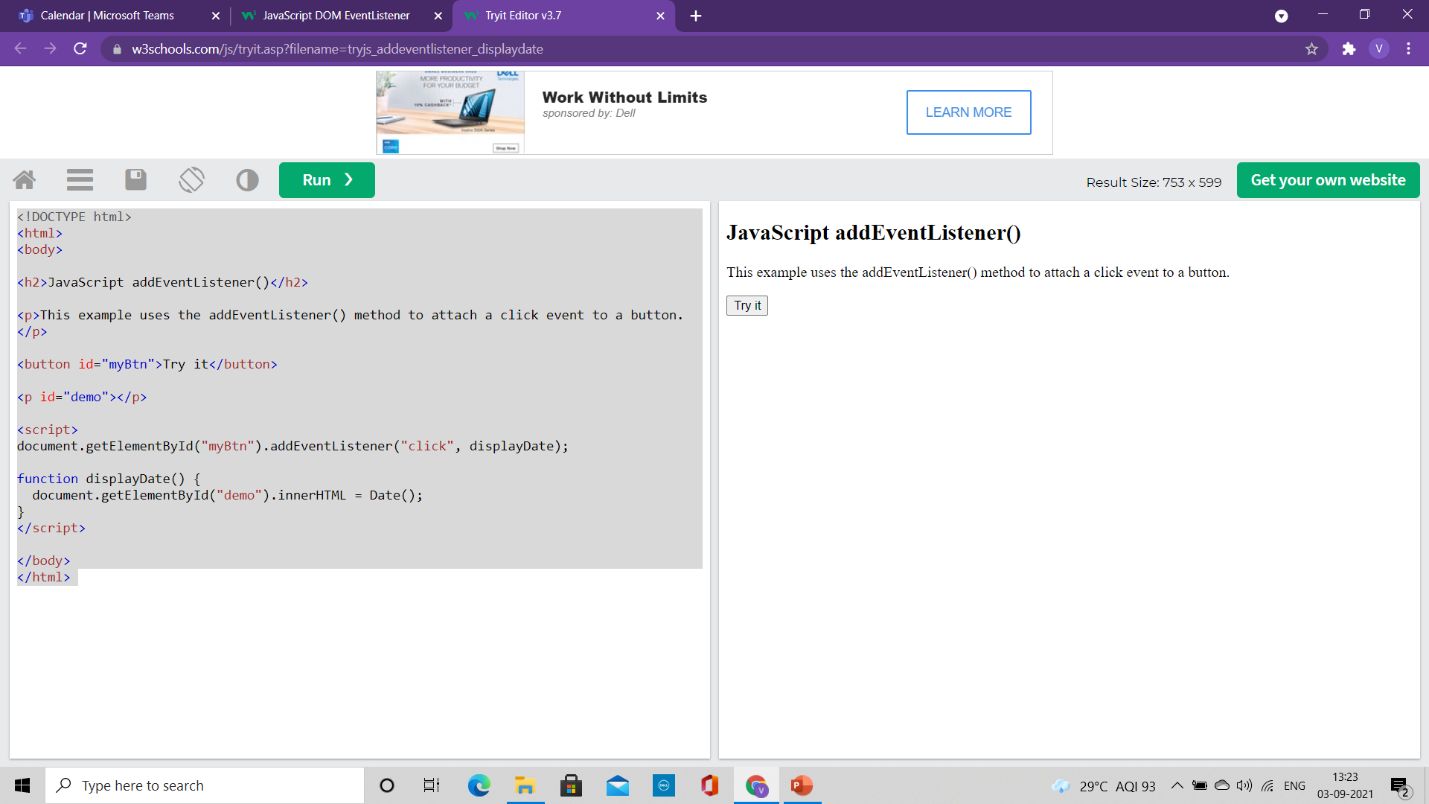
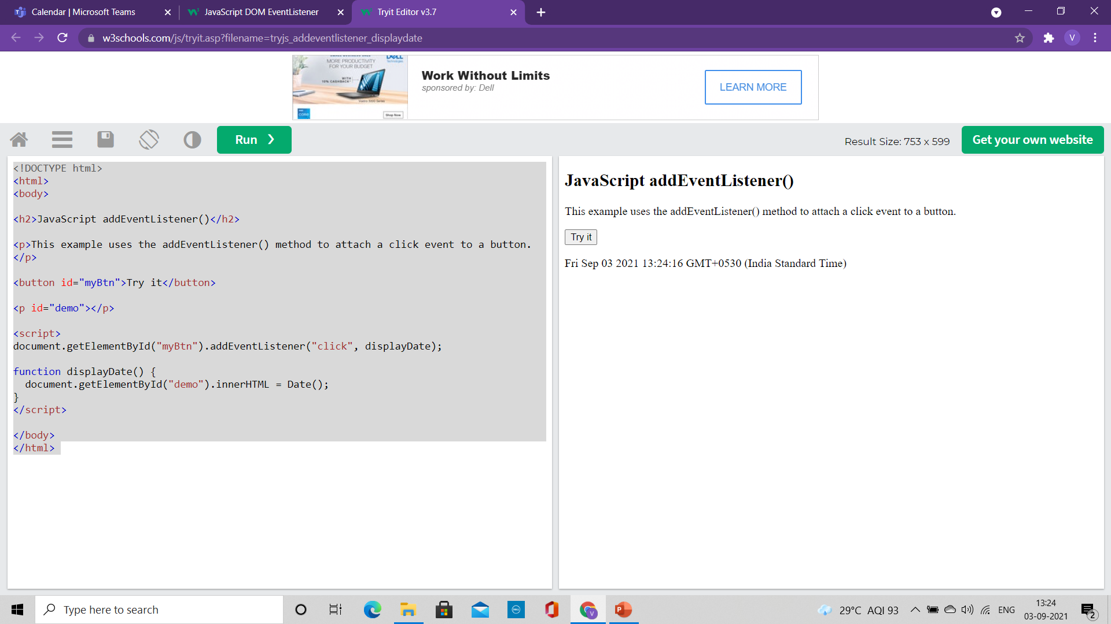
Example
<!DOCTYPE html>
<html>
<body>
<h2>JavaScript addEventListener()</h2>
<p>This example uses the addEventListener() method to attach a click event to a button.</p>
<button id="myBtn">Try it</button>
<p id="demo"></p>
<script>
document.getElementById("myBtn").addEventListener("click", displayDate);
function displayDate() {
document.getElementById("demo").innerHTML = Date();
}
</script>
</body>
</html>
Here external function displaydate( ) is written.

Slide 19
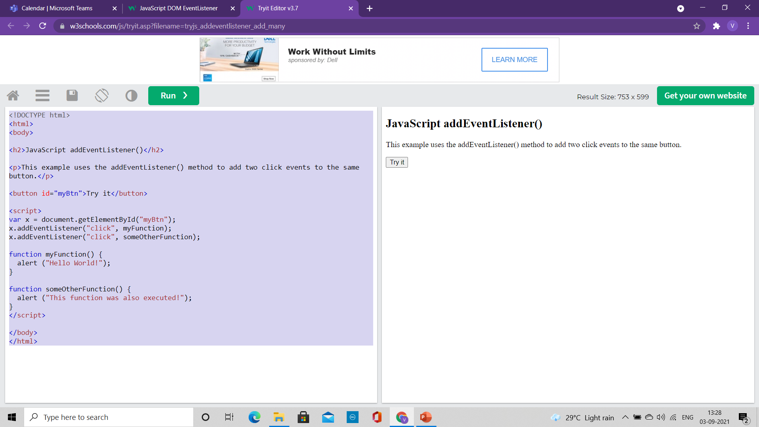
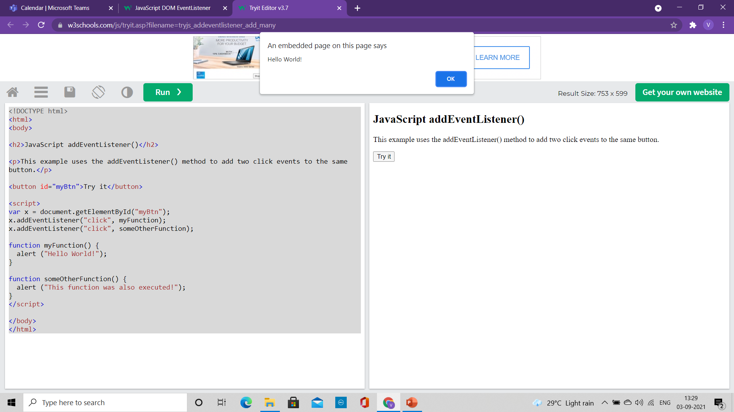
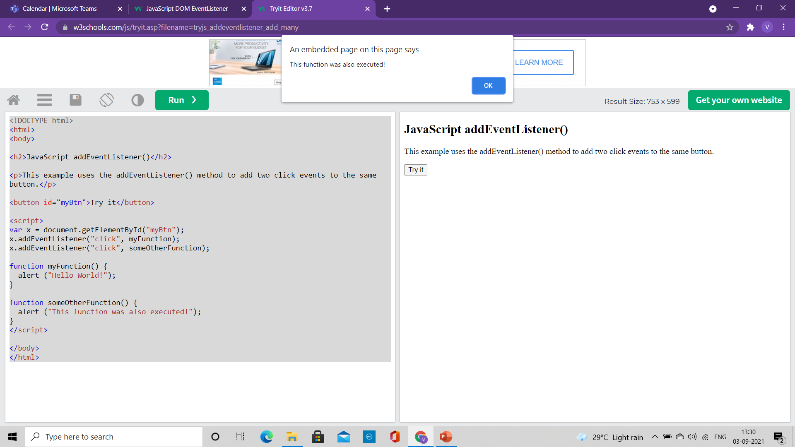
Many Event Handler to same element
<!DOCTYPE html>
<html>
<body>
<h2>JavaScript addEventListener()</h2>
<p>This example uses the addEventListener() method to add two click events to the same button.</p>
<button id="myBtn">Try it</button>
<script>
var x = document.getElementById("myBtn");
x.addEventListener("click", myFunction);
x.addEventListener("click", someOtherFunction);
function myFunction() {
alert ("Hello World!");
}
function someOtherFunction() {
alert ("This function was also executed!");
}
</script>
</body>
</html>
Two events are defined for button click

Slide 20
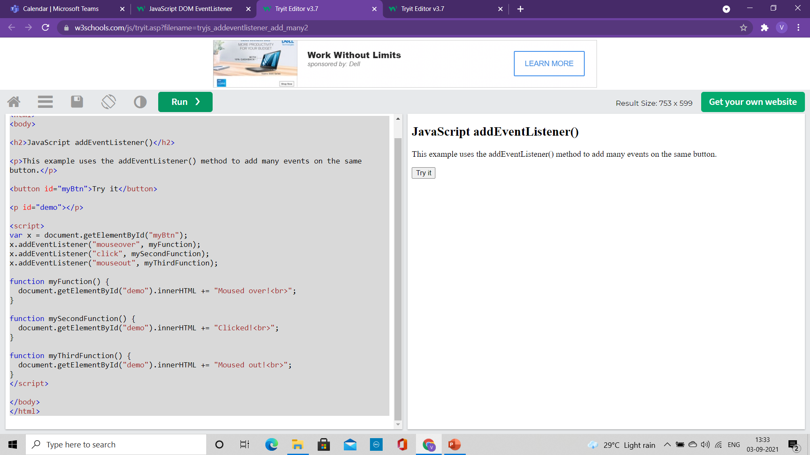
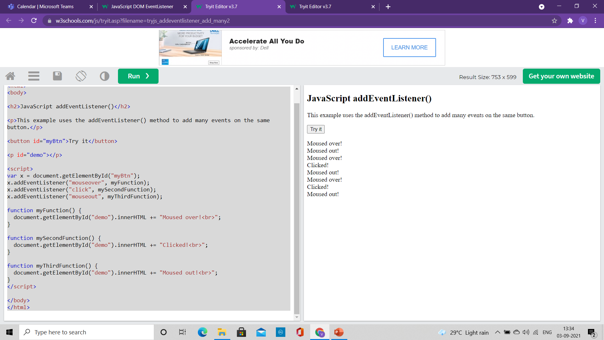
Many Event Handler to same element
<!DOCTYPE html>
<html>
<body>
<h2>JavaScript addEventListener()</h2>
<p>This example uses the addEventListener() method to add many events on the same button.</p>
<button id="myBtn">Try it</button>
<p id="demo"></p>
<script>
var x = document.getElementById("myBtn");
x.addEventListener("mouseover", myFunction);
x.addEventListener("click", mySecondFunction);
x.addEventListener("mouseout", myThirdFunction);
function myFunction() {
document.getElementById("demo").innerHTML += "Moused over!<br>";
}
function mySecondFunction() {
document.getElementById("demo").innerHTML += "Clicked!<br>";
}
function myThirdFunction() {
document.getElementById("demo").innerHTML += "Moused out!<br>";
}
</script>
</body>
</html>
You can add events of different types to the same element

Slide 21
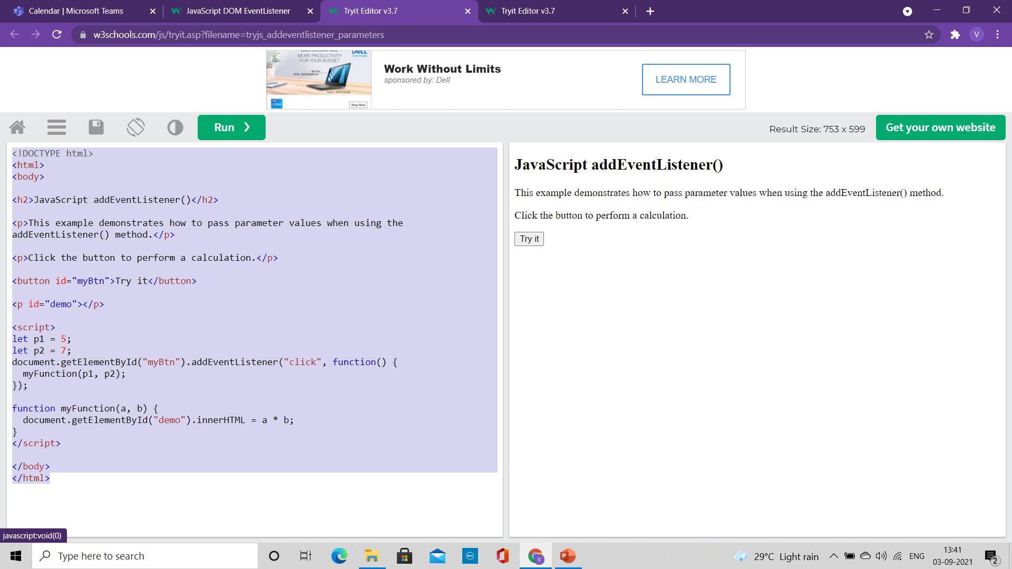
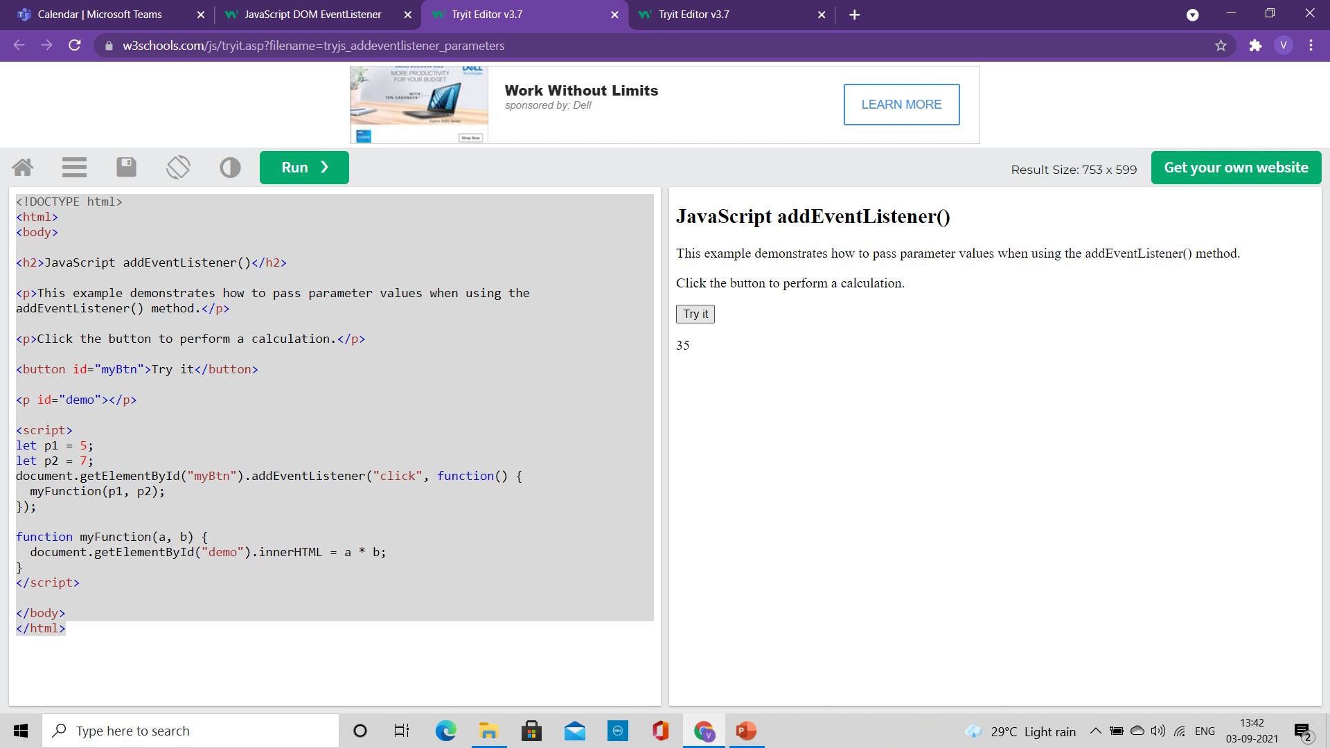
Passing Parameters
When passing parameter values, use an "anonymous function" that calls the specified function with the parameters
<!DOCTYPE html>
<html>
<body>
<h2>JavaScript addEventListener()</h2>
<p>This example demonstrates how to pass parameter values when using the addEventListener() method.</p>
<p>Click the button to perform a calculation.</p>
<button id="myBtn">Try it</button>
<p id="demo"></p>
<script>
let p1 = 5;
let p2 = 7;
document.getElementById("myBtn").addEventListener("click", function() {
myFunction(p1, p2);
});
function myFunction(a, b) {
document.getElementById("demo").innerHTML = a * b;
}
</script>
</body>
</html>

Slide 22
Event Bubbling or Event Capturing?
There are two ways of event propagation in the HTML DOM
Bubbling: In bubbling the inner most element's event is handled first and then the outer
Capturing: In capturing the outer most element's event is handled first and then the inner
Event propagation is a way of defining the element order when an event occurs.
If you have a <p> element inside a <div> element, and the user clicks on the <p> element, which element's "click" event should be handled first?
In bubbling: the <p> element's click event is handled first, then the <div> element's click event.
In capturing: the <div> element's click event will be handled first, then the <p> element's click event.

Slide 23
Event Bubbling or Event Capturing?
Syntax:
With the addEventListener() method we can specify the propagation type by using the "useCapture" parameter:
addEventListener(event, function, useCapture);
The default value is false, which will use the bubbling propagation,
when the value is set to true, the event uses the capturing propagation.

Slide 24
Event Bubbling and Event Capturing
<!DOCTYPE html>
<html>
<head>
<style>
#myDiv1, #myDiv2 {
background-color: coral;
padding: 50px;
}
#myP1, #myP2 {
background-color: white;
font-size: 20px;
border: 1px solid;
padding: 20px;
}
</style>
<meta content="text/html; charset=utf-8" http-equiv="Content-Type">
</head>
<body>
<h2>JavaScript addEventListener()</h2>
<div id="myDiv1">
<h2>Bubbling:</h2>
<p id="myP1">Click me!</p>
</div><br>
<div id="myDiv2">
<h2>Capturing:</h2>
<p id="myP2">Click me!</p>
</div>
<script>
document.getElementById("myP1").addEventListener("click", function() {
alert("You clicked the white element!");
}, false);
document.getElementById("myDiv1").addEventListener("click", function() {
alert("You clicked the orange element!");
}, false);
document.getElementById("myP2").addEventListener("click", function() {
alert("You clicked the white element!");
}, true);
document.getElementById("myDiv2").addEventListener("click", function() {
alert("You clicked the orange element!");
}, true);
</script>
</body>
</html>

Slide 25
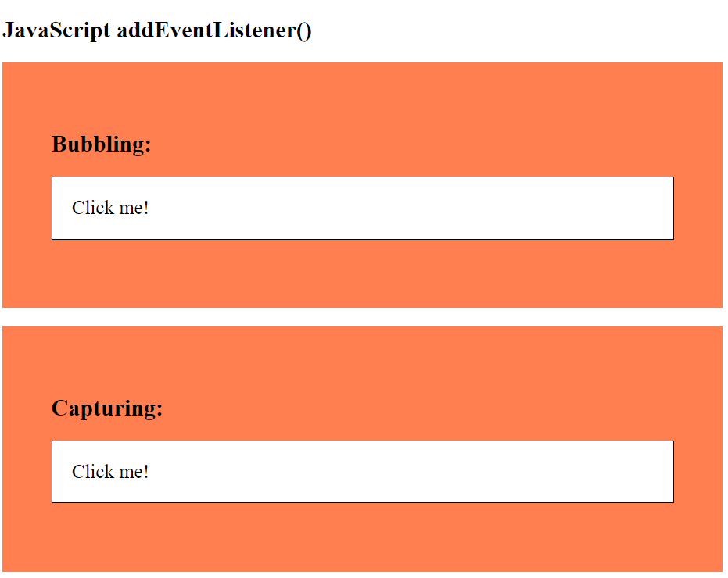
Event Bubbling and Event Capturing
<script>
document.getElementById("myP1").addEventListener("click", function() {
alert("You clicked the white element!");
}, false);
document.getElementById("myDiv1").addEventListener("click", function() {
alert("You clicked the orange element!");
}, false);
document.getElementById("myP2").addEventListener("click", function() {
alert("You clicked the white element!");
}, true);
document.getElementById("myDiv2").addEventListener("click", function() {
alert("You clicked the orange element!");
}, true);
</script>
</body>
</html>

Slide 26
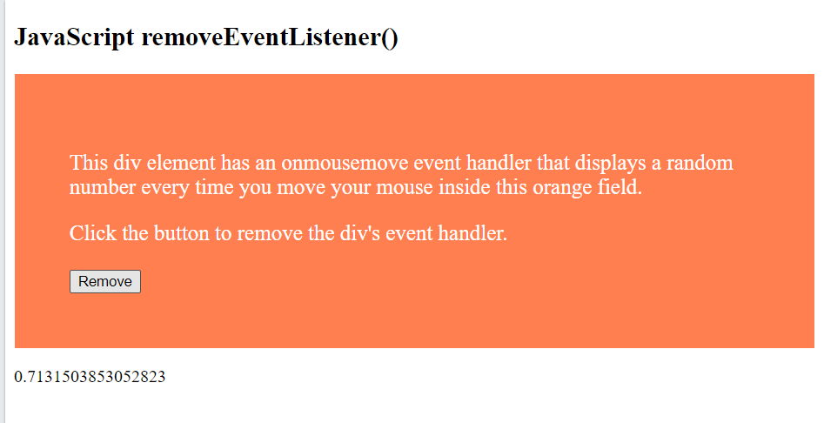
The removeEventListener() method
It removes event handlers that have been attached with the addEventListener() method:
<!DOCTYPE html>
<html>
<head>
<style>
#myDIV {
background-color: coral; border: 1px solid; padding: 50px; color: white; font-size: 20px;
}
</style>
</head>
<body>
<h2>JavaScript removeEventListener()</h2>
<div id="myDIV">
<p>This div element has an onmousemove event handler that displays a random number every time you move your mouse inside this orange field.</p>
<p>Click the button to remove the div's event handler.</p>
<button onclick="removeHandler()" id="myBtn">Remove</button>
</div>
<p id="demo"></p>
<script>
document.getElementById("myDIV").addEventListener("mousemove", myFunction);
function myFunction() {
document.getElementById("demo").innerHTML = Math.random();
}
function removeHandler() {
document.getElementById("myDIV").removeEventListener("mousemove", myFunction);
}
</script>
</body>
</html>

